Slide 1
24
7
30
Date: /9/2018
Linear Relationships
EQ – How do I find a linear relationship from a table?
25

Slide 2
Linear Relationships – Finding a Rule From a Table
Year 9 Maths

Slide 3
24
7
30
Date: /9/2018
Linear Relationships
EQ – How do I find a linear relationship from a table?
25

Slide 4
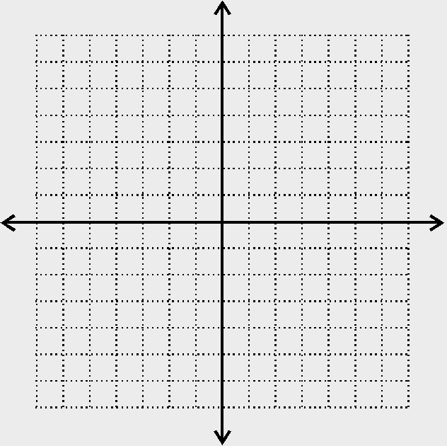
Give the coordinates of each point:
A
B
C
D

Slide 5
24
7
30
Date: /9/2018
Linear Relationships
EQ – How do I find a linear relationship from a table?
25

Slide 6
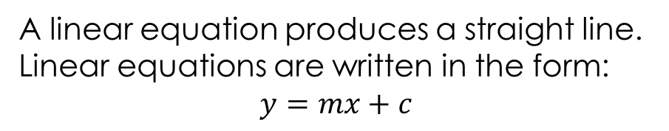
24
7
30
Date: /9/2018
Linear Relationships
EQ – How do I find a linear relationship from a table?
What is a linear relationship?
A linear equation produces a straight line. Linear equations are written in the form: $$y=mx+c$$
What is m? What is c?
25

Slide 7
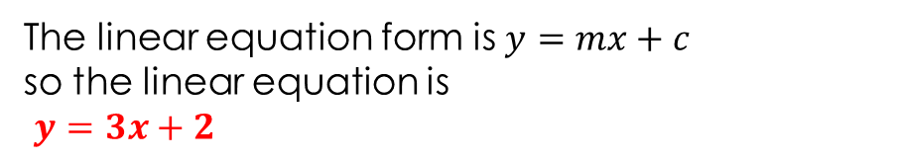
24
7
30
Date: /9/2018
Linear Relationships
EQ – How do I find a linear relationship from a table?
How do I create a linear equation (or rule) from a table?
Example: Find the linear equation from this table of values.
0
x | 1 | 2 | 3 | 4 | 5 | 6 | 7
y | 5 | 8 | 11 | 14 | 17 | 20 | 23
2
+3 +3 +3
x= 0, y = 2
Find the difference pattern in the y-values. This is the value of m.
2) Work out what y would be when x = 0.
The linear equation form is $y=mx+c$
so the linear equation is
$y=3x+2$
25

Slide 8
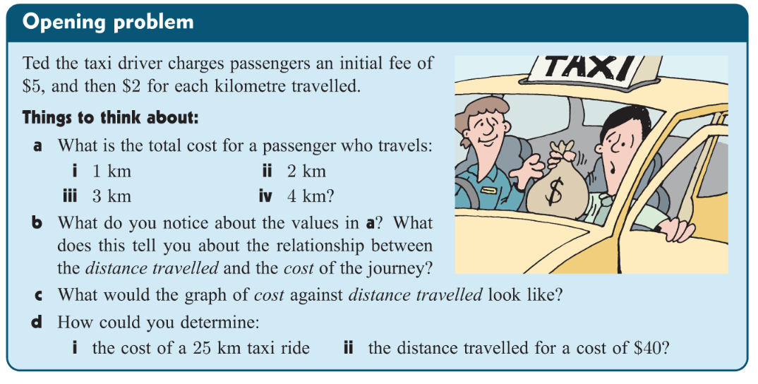

Slide 9
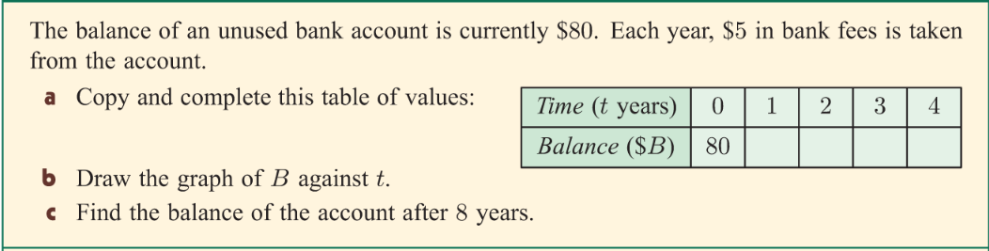
7 minutes

Slide 10
Page 84 & 85

